Slide 2
History
Started in 2012
Philosophy:
High efficiency biomass to charcoal
Robust and simple technology
No hazardous emissions
Affordable production costs

Slide 3
Philosophy
Robust and simple technology
No heavy equipment for loading/unloading
Most construction work on location
Construction materials readily available
No advanced process control equipment

Slide 4
Philosophy
High efficiency
Heating (combustion) separated from carbonisation
Drying and carbonisation separated
Energy content volatiles used for process heating

Slide 5
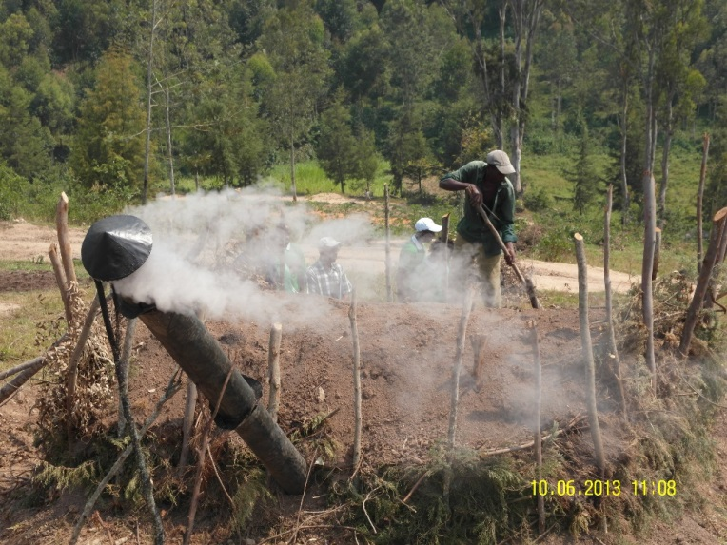
Philosophy
No hazardous emissions
- Prevention of emissions of black vapours by combustion in wood stove
- Health problem workers and environmental
problem avoided

Slide 6
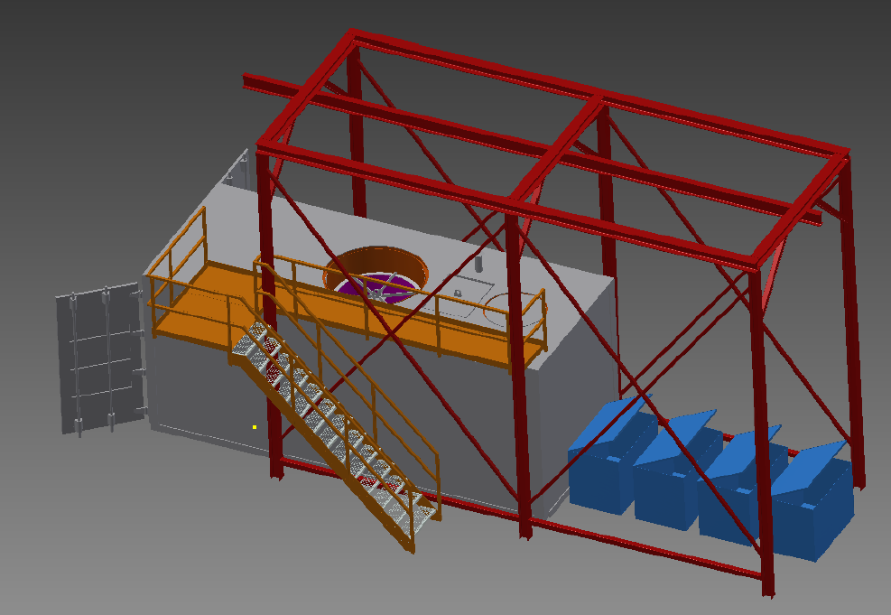
First design

Slide 7
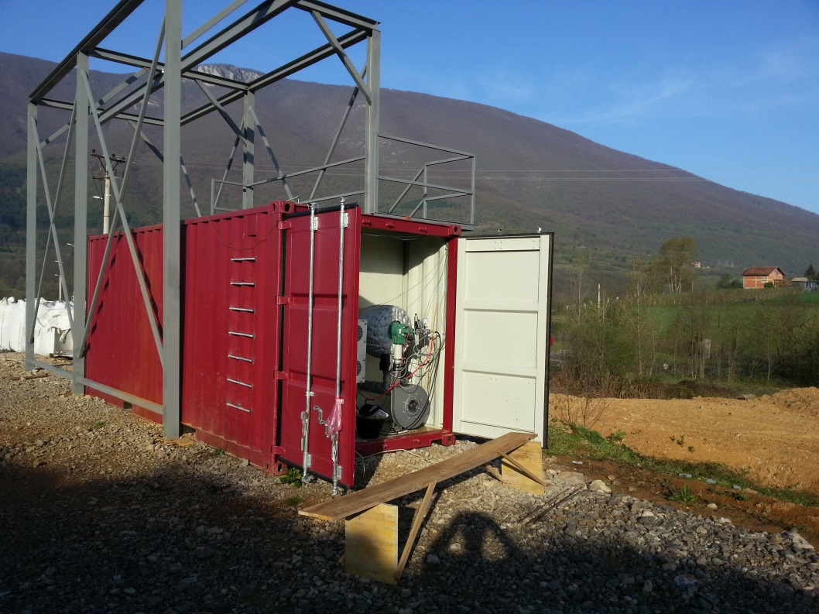
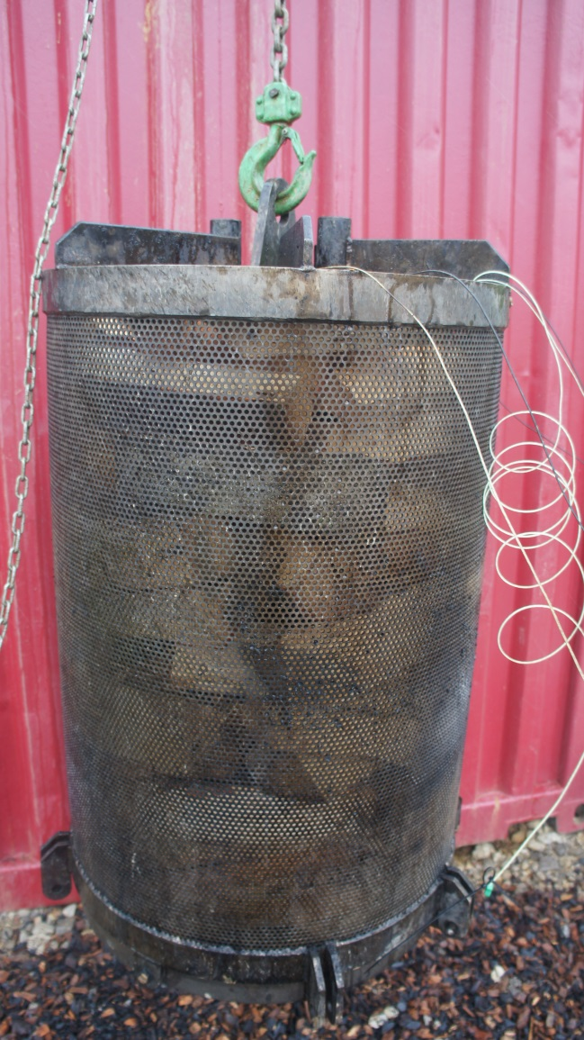
Demo plant in Bosnia

Slide 8
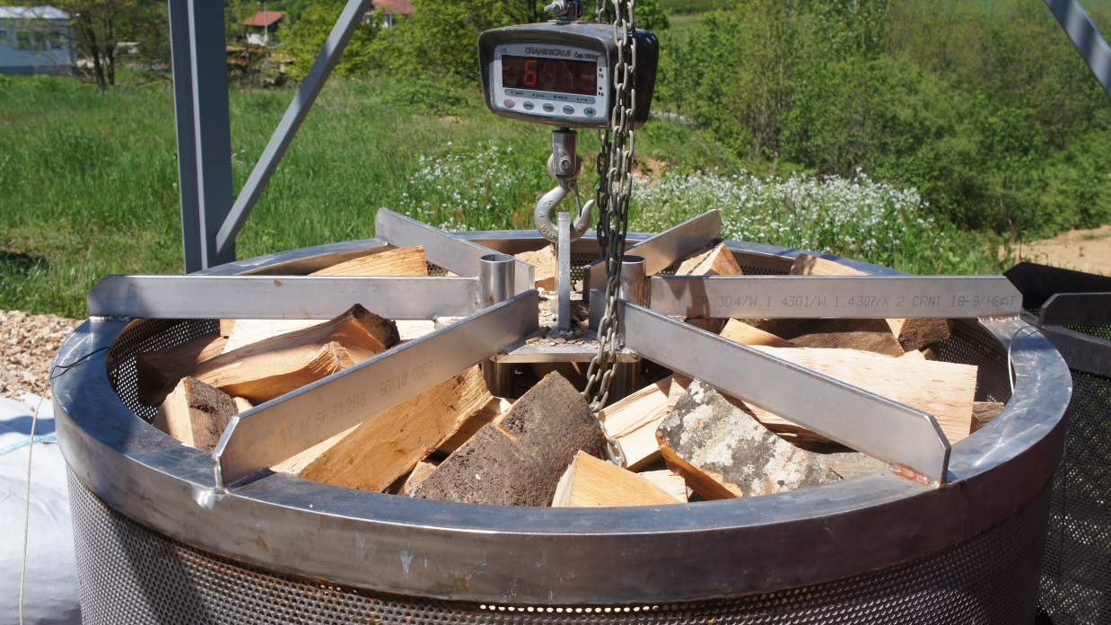
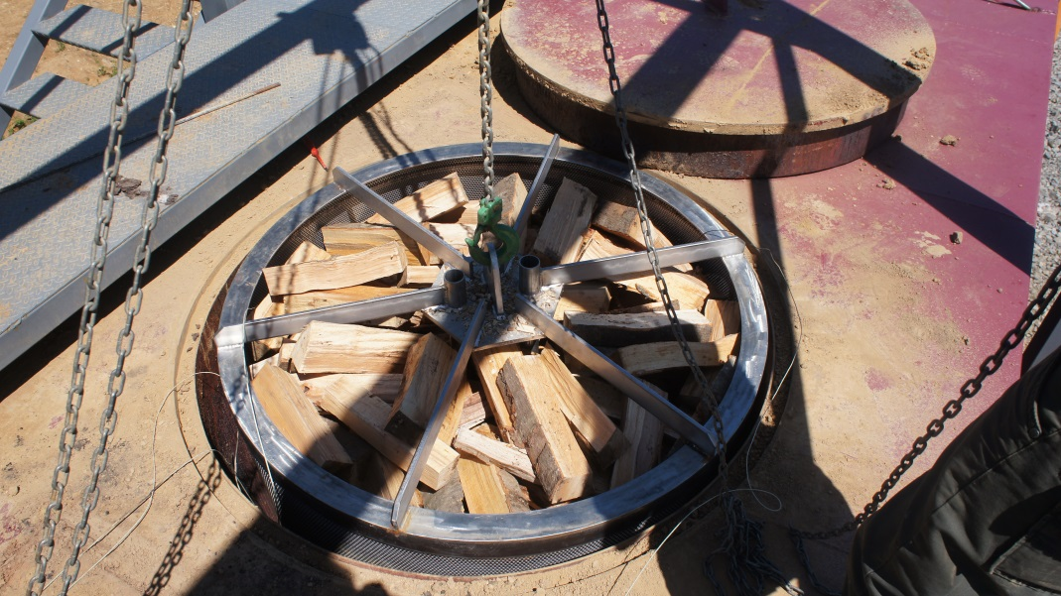

Slide 9
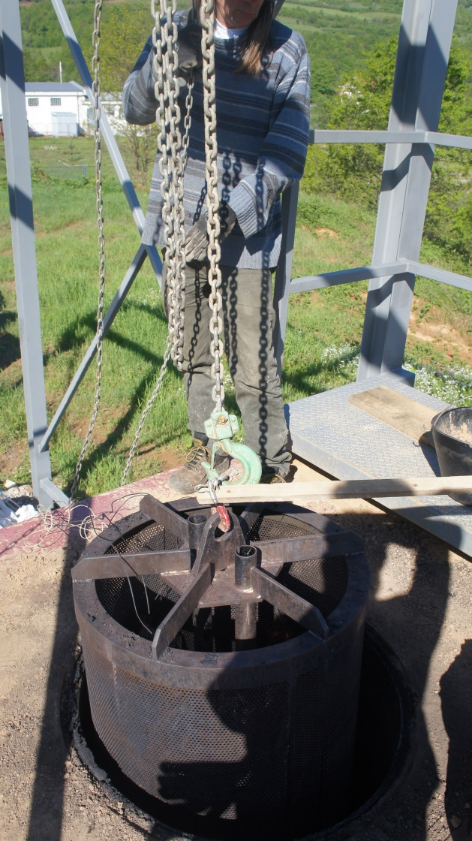
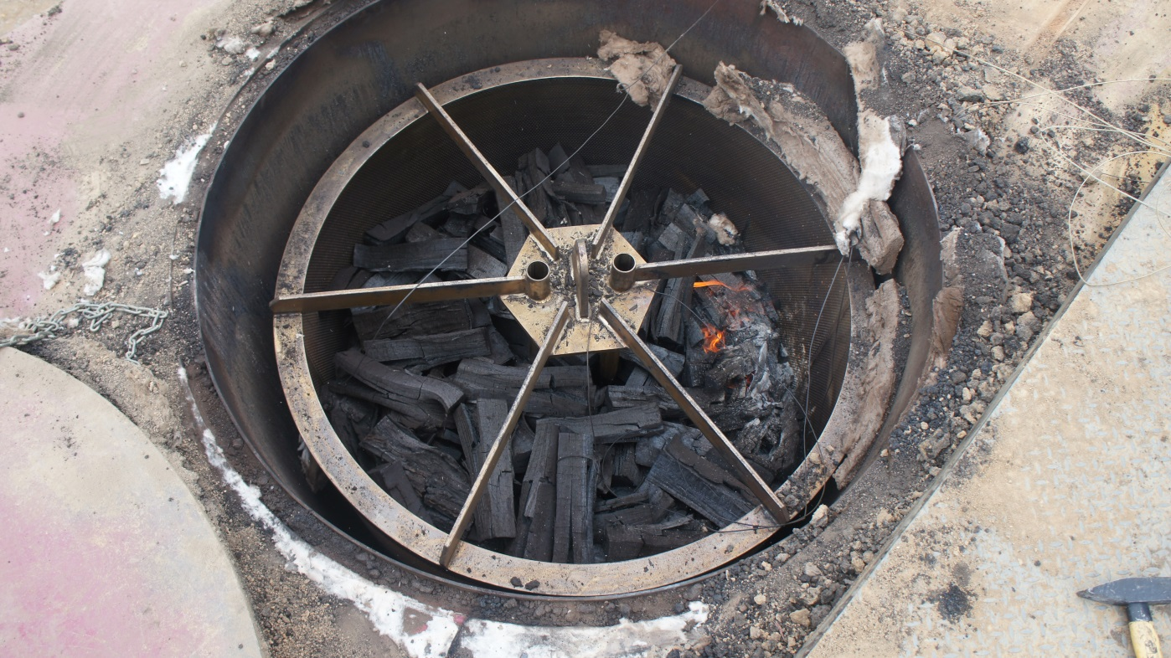

Slide 10
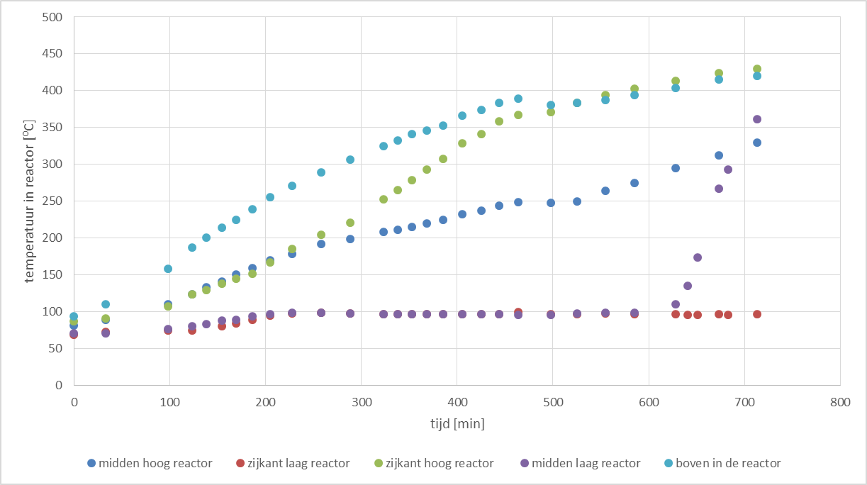
Results tests

Slide 11
Results tests
Long drying time
Efficiency > 35%
After start-up process heat supply from volatile; no emissions of volatiles
Good quality charcoal
Caloric value charcoal: 30-32 MJ/kg
Temperature flue gases > 100 ºC

Slide 12
Results tests
Top loading less practical
Cooling outside reactor to decrease production time one cycle
Separate and simultaneous drying with flue gases

Slide 13
Improved design
Front loading with reactors (3,5 m³ each)
Start-up with wood stove
Volatiles are burned in wood stove
Two furnaces: one for drying and one for carbonisation
Alternating use of reactors

Slide 14
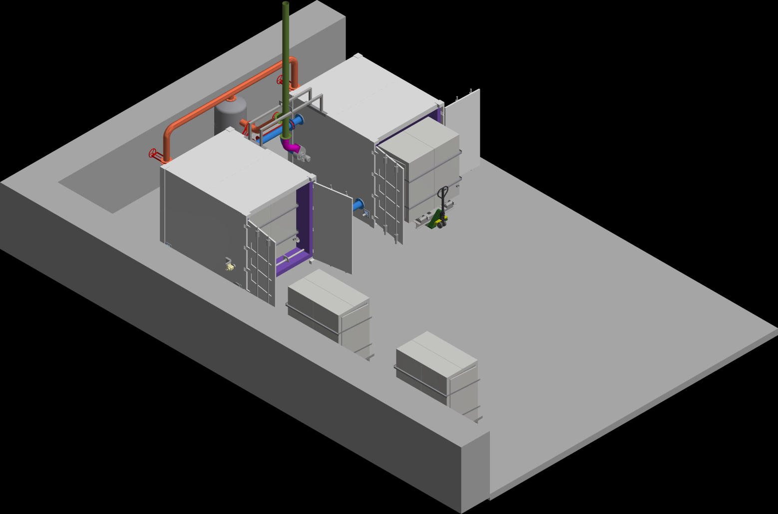
Improved design

Slide 15
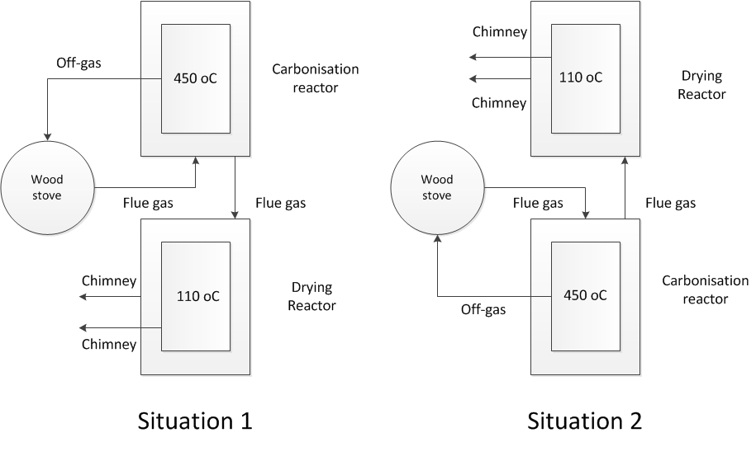
Principle

Slide 16
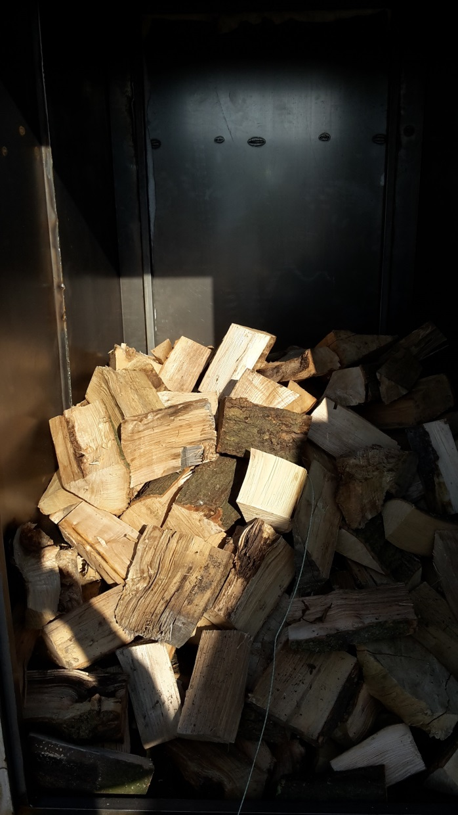
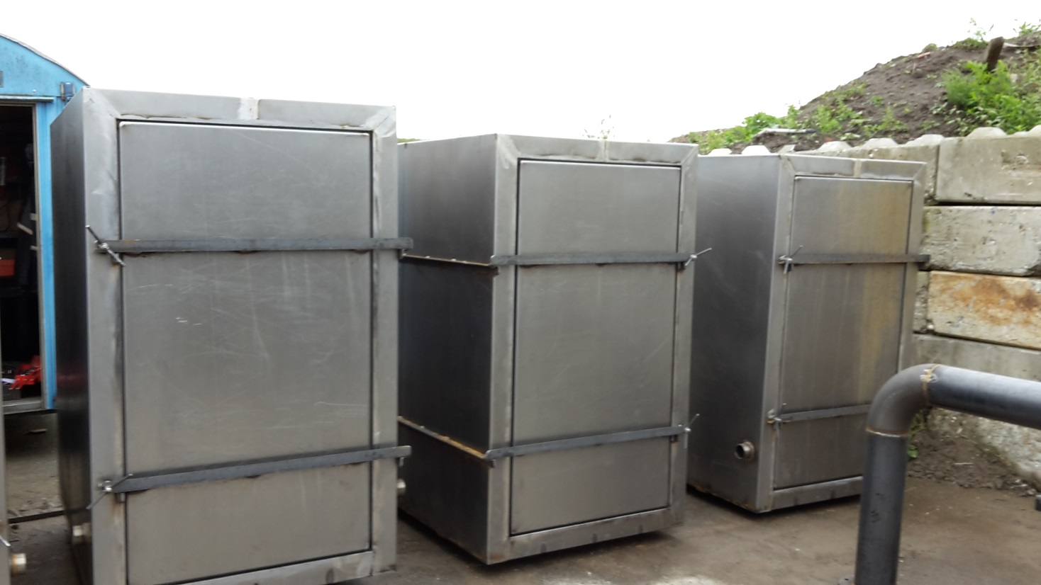

Slide 17
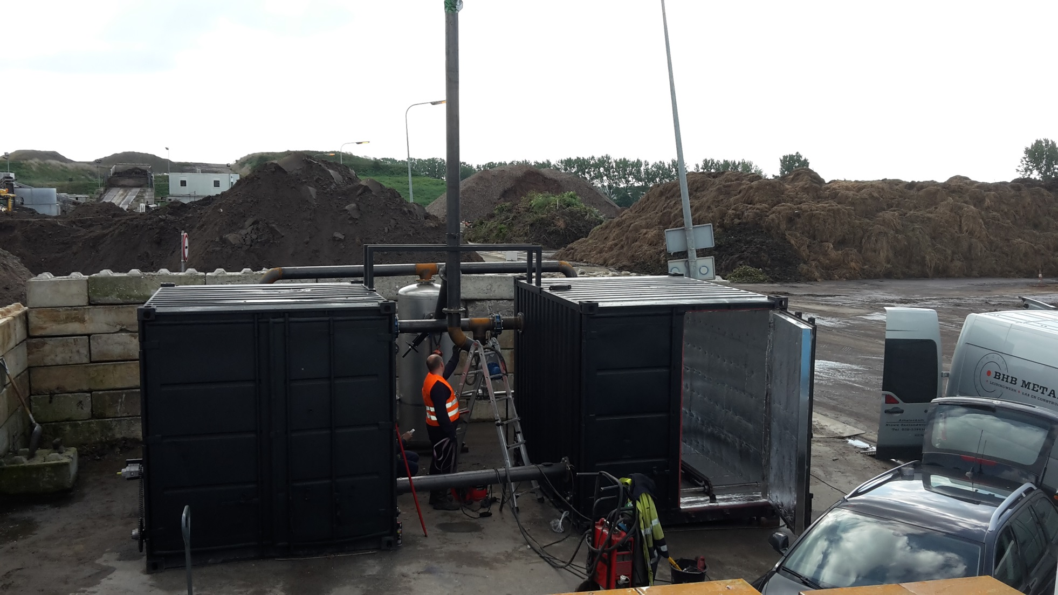

Slide 18
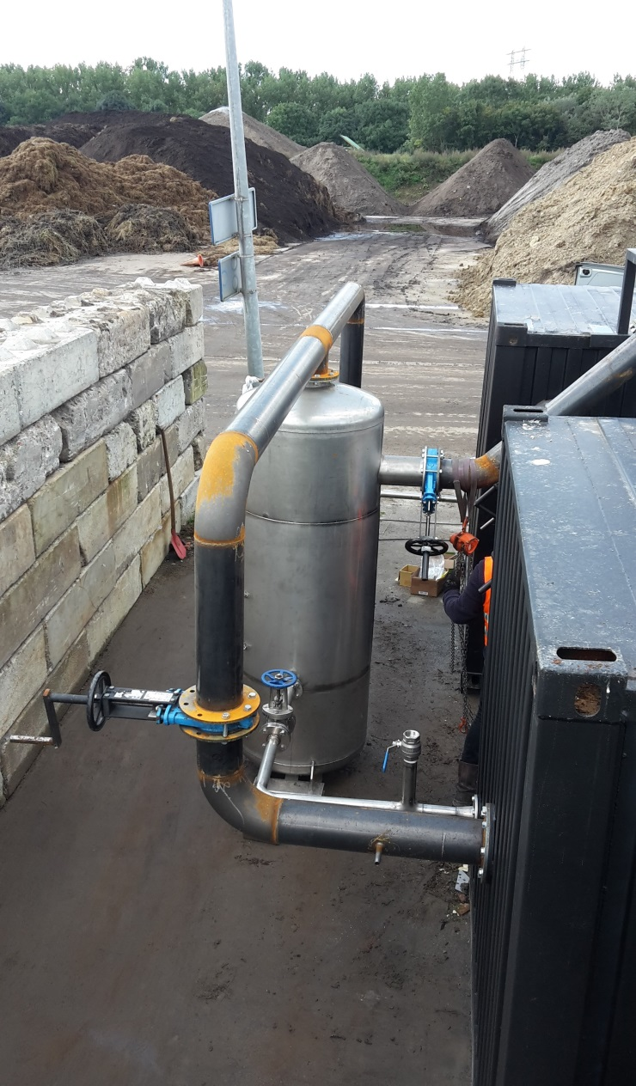
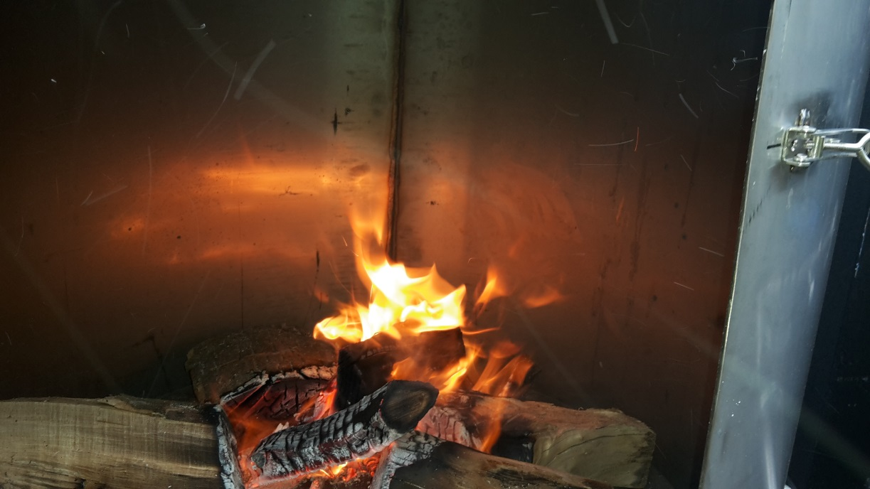

Slide 19
Production full size module
Two furnaces each with four reactors
14 m³ volume carbonisation per batch
1.000-1.100 kg charcoal per batch
2-3 batches per day (depending on type of biomass, particle size, moisture content etc.)

Slide 20
Program demo-plant 2015
Optimize time and temperature vs. quality charcoal
Operational protocol
Tests with rice hulls and sugar cane
Tests with peat
Other biomass

